Slide 1
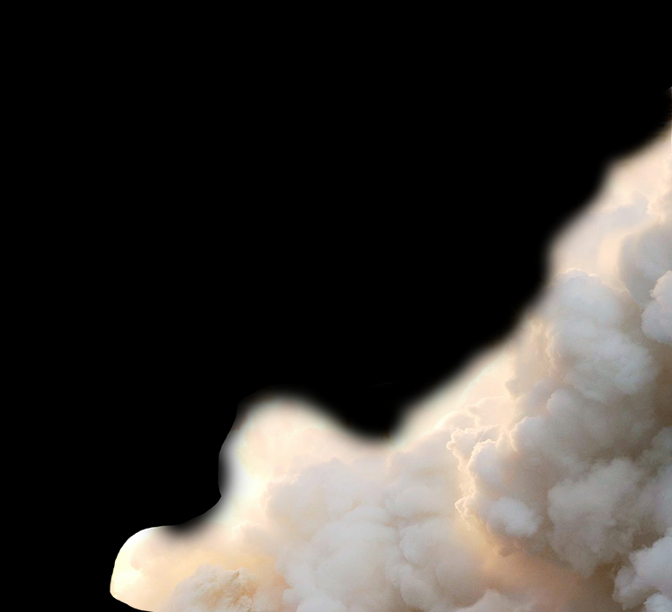
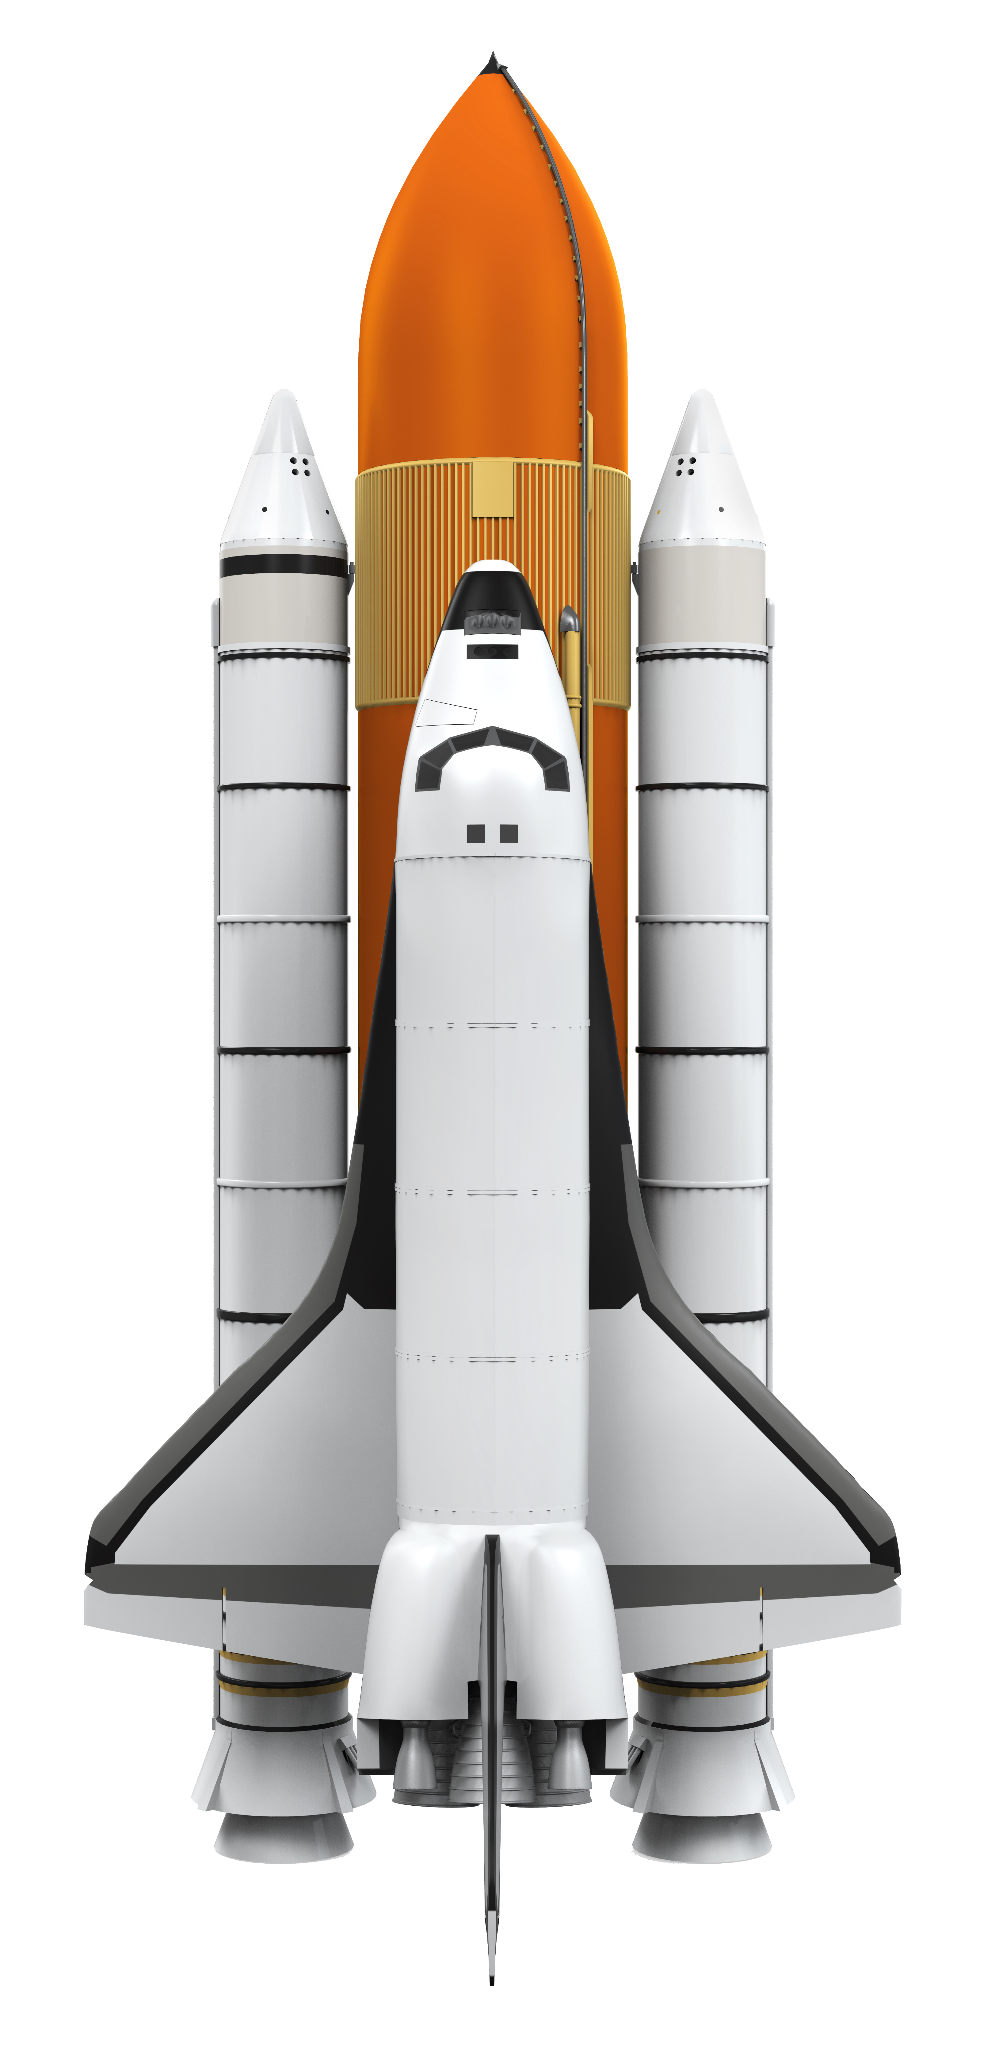
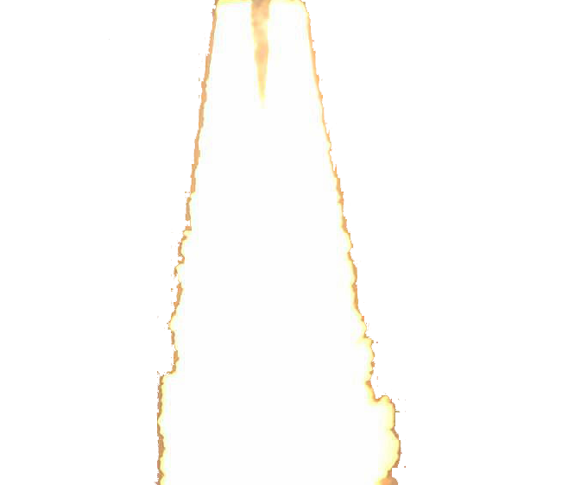

What if everyone bought into a new way to pilot, prototype
and go to market?

Slide 2
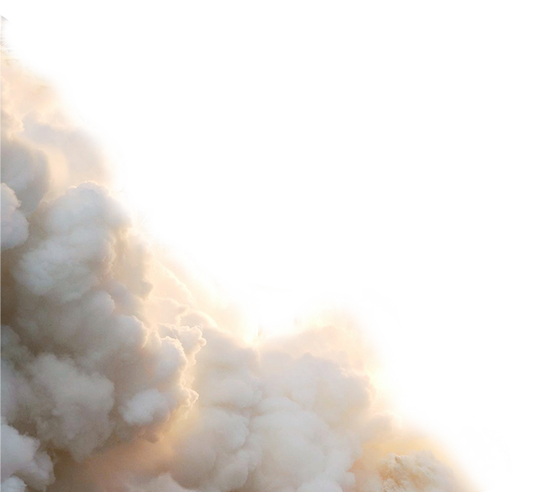
What if everyone bought into a new way to pilot, prototype
and go to market?

